Slide 1



Multi-omics Boot Camp
Analysis of Omics Data for Research Studies
Bringing it all together: Multi-omic Analysis in Real Data
Jesse Goodrich, PhD
University of Southern California
jagoodri@usc.edu
David Conti
Hongxu Wang
Qiran Jia

Slide 2
Overview
Goal: Illustrate multi-omics data analysis approaches applied to real data.
Background:
Data: HELIX data
Exposure: Maternal Arsenic Exposure
Outcome: Liver Injury
Omics: 5 omics layers
Analysis: Examine whether multi-omics signatures mediate associations of arsenic and liver injury using:
Mediation without dimensionality reduction
Mediation with dimensionality reduction/clustering
Quasi-mediation

Slide 3
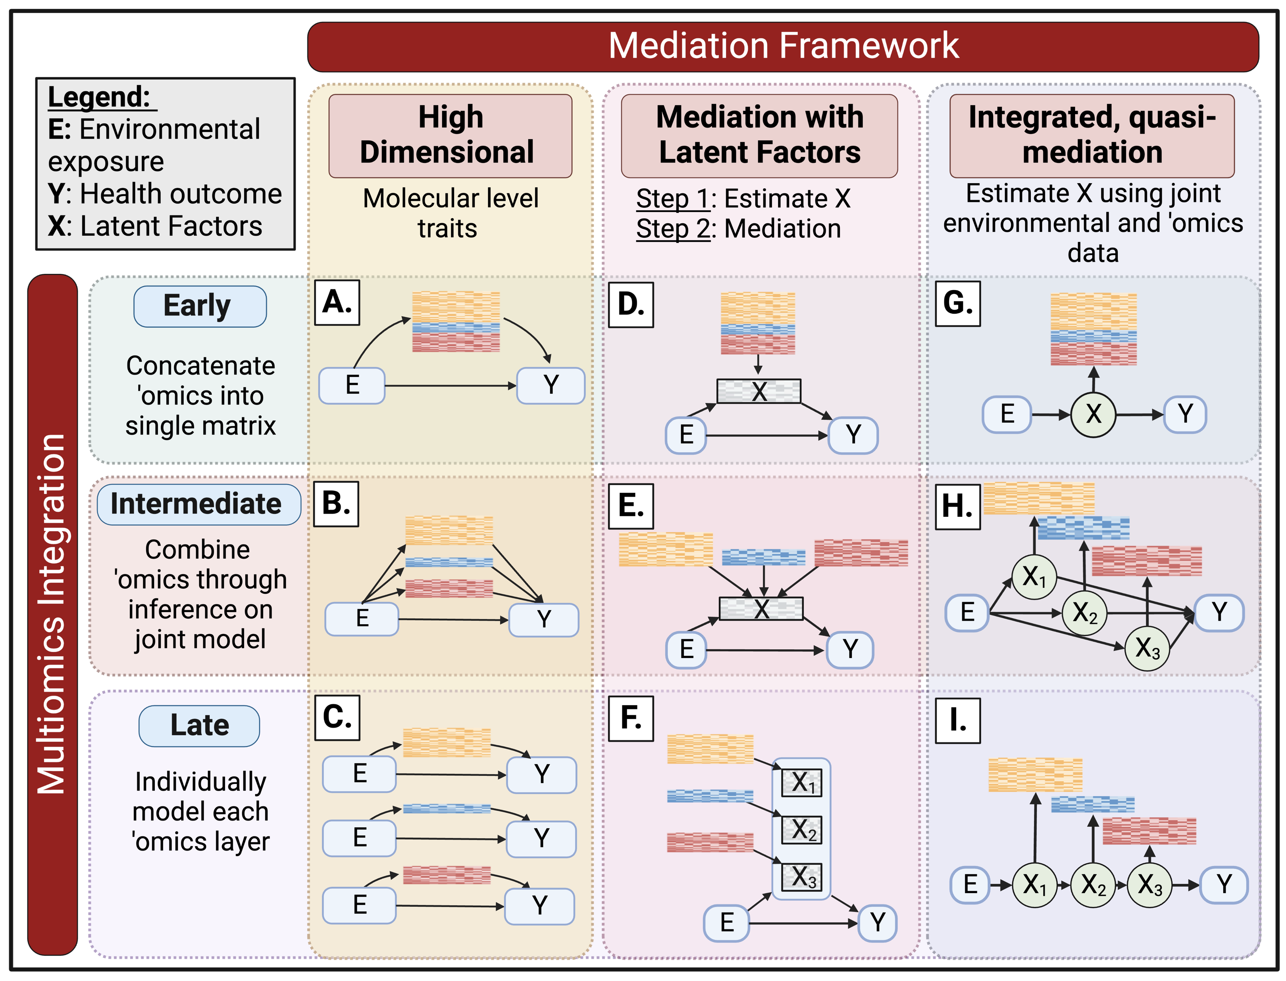
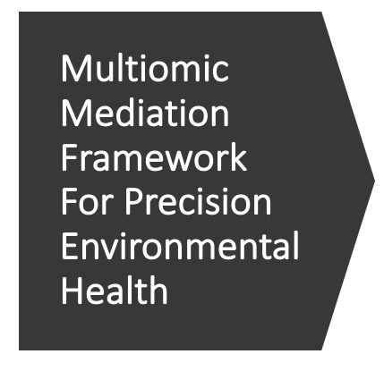
Multiomic Mediation Framework For Precision Environmental Health

Slide 4
Multiomic Mediation Framework For Precision Environmental Health

Slide 5
Multiomic Mediation Framework For Precision Environmental Health

Slide 6
Multiomic Mediation Framework For Precision Environmental Health

Slide 7
Multiomic Mediation Framework For Precision Environmental Health

Slide 8
Application Of Framework: A Case Study On Maternal Arsenic And Childhood Liver Injury

Slide 9
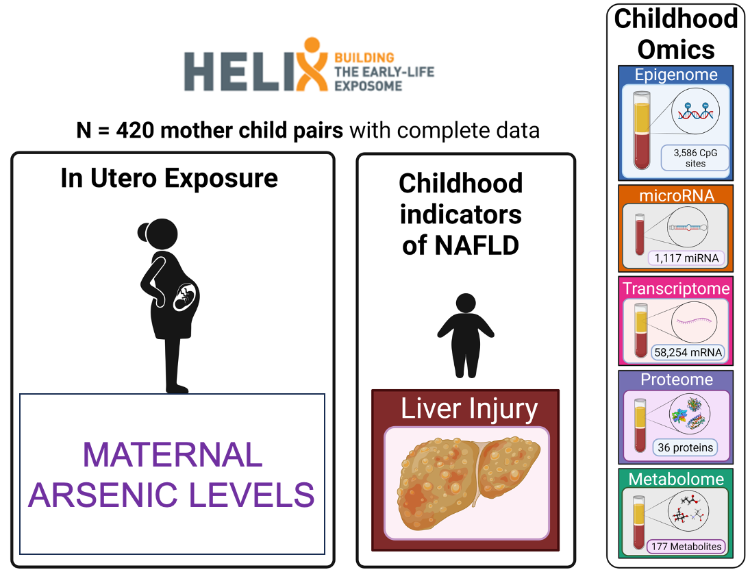

Slide 10
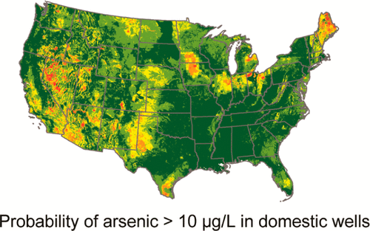
What is Arsenic?
How are we exposed?
Arsenic compounds are in soils, sediments, and groundwater
Occur naturally or from industrial processes
Exposure is primarily through contaminated water and food
Have several adverse health effects
Ayotte et al., Environ Sci Technol, 2017
Sunderland et al., J Expos Sci & Epidemiol, 2019
Notes:
10 uG/L is the EPA maximum contamination limit.

Slide 11
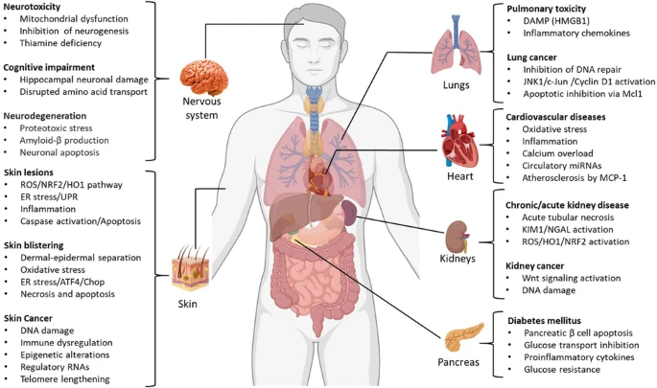
Arsenic Health Effects
Muzaffar et al, Cell Biology and Toxicology, 2020

Slide 12
Exposure outcome association: In utero arsenic exposure linked to childhood liver injury
Maternal Exposure | Beta (95% CI) | p-value
Arsenic | 0.64 (0.06, 1.20) | 0.029
Cadmium | 0.86 (-0.23, 1.90) | 0.12
Cobalt | 0.92 (-0.32, 2.20) | 0.15
Cesium | -0.19 (-2.70, 2.30) | 0.88
Copper | -3.20 (-7.90, 1.50) | 0.18
Mercury | 0.59 (-0.32, 1.50) | 0.20
Manganese | 1.90 (-0.37, 4.20) | 0.10
Molybdenum | 0.12 (-1.50, 1.70) | 0.89
Lead | -0.01 (-1.50, 1.50) | 0.99
Maternal Blood Arsenic associated with childhood liver enzymes in 420 mother-child pairs
Outcome: Childhood ALT (U/L)
Associations significant after adjusting for child sex, child age, maternal smoking, HELIX cohort, and fish intake

Slide 13
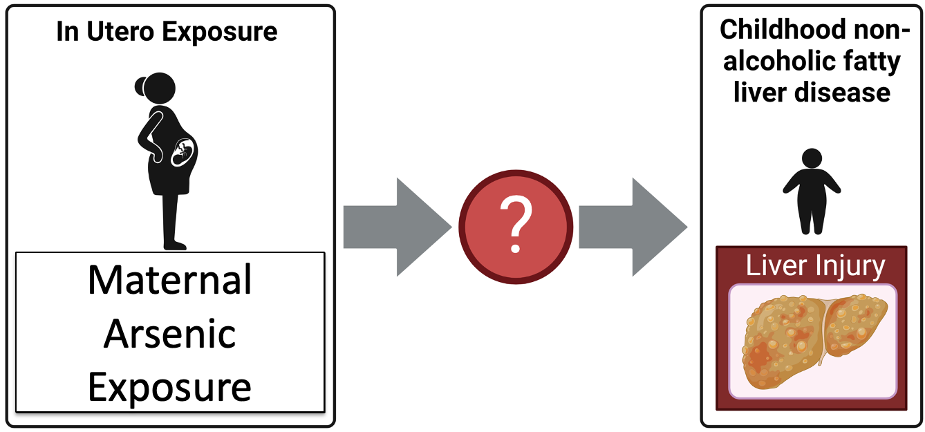
However, the mechanisms are not clear

Slide 14
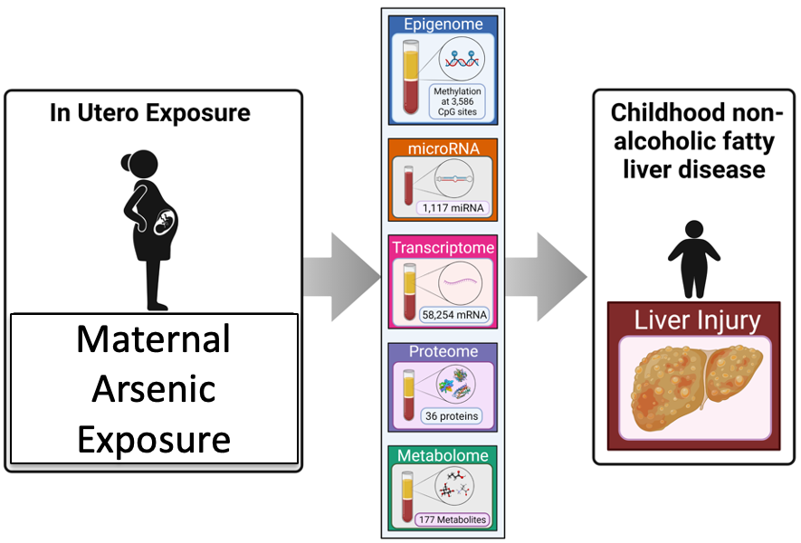
Goal: Integrate multi-omics data to understand mechanisms linking PFAS & liver injury

Slide 15
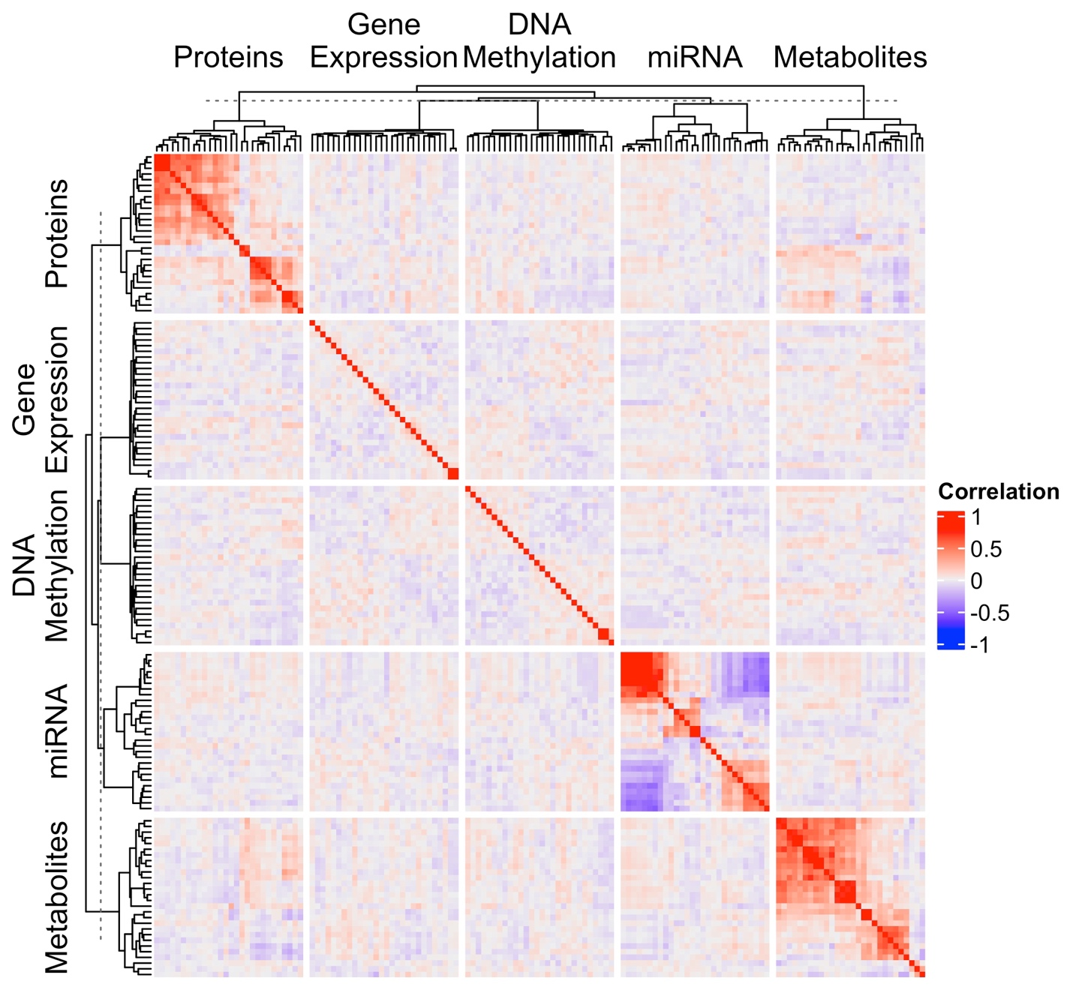
Importance of using multiomic methods in this data
Notes:
it’s crucial to use dedicated multiomics methods for these types of analyses because:
Different Correlation Structures: Each omics layer has unique correlation structures due to the different biological mechanisms they represent. For instance, transcriptomic data may reflect gene co-expression networks and proteomic data shows protein-protein interactions. Multiomics methods incorporate these correlation structures into their models, thus enabling more accurate integration and interpretation of the data.
Heterogeneity and Noise: Each omics layer is subject to different sources and levels of noise and heterogeneity, related to both technical variability (e.g., measurement error, batch effects) and biological variability (e.g., individual differences, tissue-specific expression). Dedicated multiomics methods can account for these differences, for example, through normalization techniques, the use of control samples, or statistical methods to model variability.
Biological Interpretability: Each omics dataset has its unique set of biological annotations (e.g., genomic location, gene function, pathway information). Dedicated multiomics methods can integrate these annotations to facilitate the biological interpretation of the results, leading to more meaningful and actionable insights.
Different Dimensionality: Each omics layer has different dimensionality. Genomic data, for instance, deals with thousands to millions of genetic variants. Transcriptomics data, on the other hand, involves the expression levels of tens of thousands of genes. Metabolomics data may consist of a few hundreds to thousands of metabolite levels. The dimensional differences can cause significant challenges in integrating data, particularly when it comes to aligning, scaling, and comparing across different types of data. Dedicated multiomics methods are designed to handle these challenges by incorporating techniques for dimensionality reduction and normalization across different omics layers.
However, for ease of presenting the results, here I restricted the analysis to only the top features based on a meet-in-the-middle approach for analysis.

Slide 16
Approach 1: High Dimensional Mediation
Environmental Omics Profiles

Slide 17
High Dimensional Mediation Approaches
A: Early Integration.
HIMA with concatenated omics
B. Intermediate integration
No established methods… yet!
C. Late Integration
HIMA on omics layers individually

Slide 18
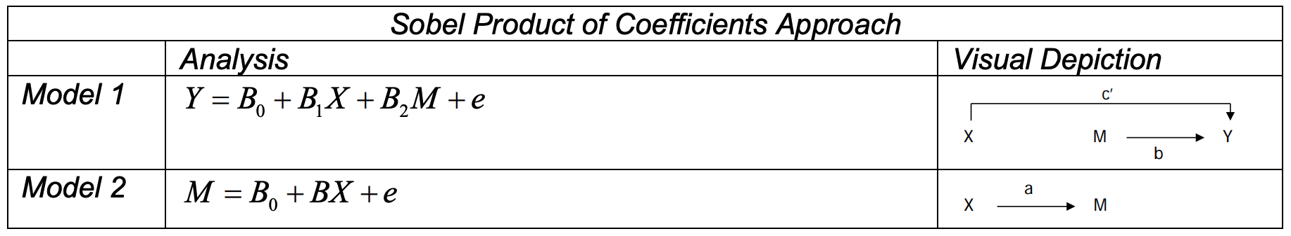
High dimensional mediation with intermediate integration
Steps:
Model 2: regular linear regression
Model 1: group lasso using xtune with c = 1
Indirect effect and CIs calculated with R package RMediation

Slide 19
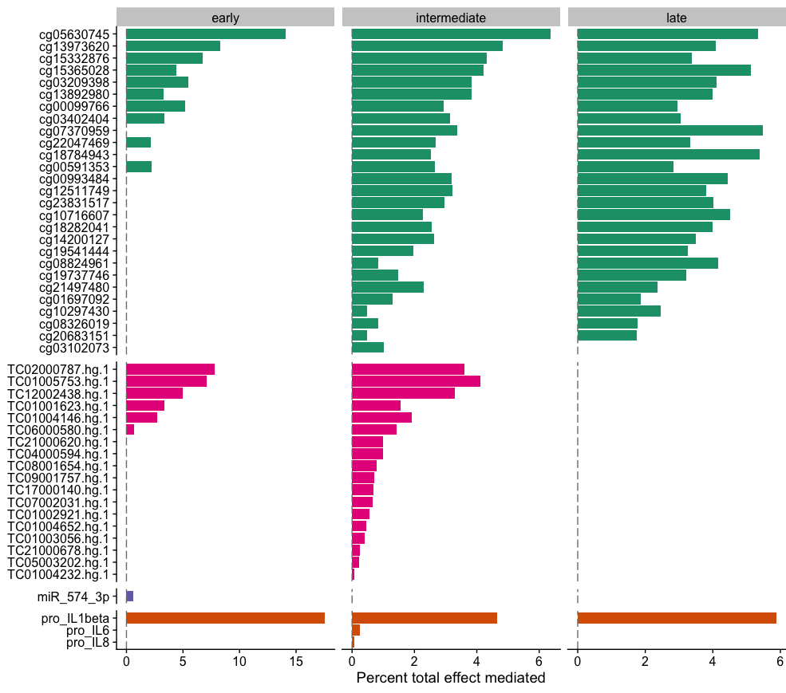
Approach 1: Results

Slide 20
Summary: High Dimensional Mediation
HIMA with Late integration selects features without accounting for correlation structures across omics layers
HIMA with Early integration accounts for correlations between all features, and selected features are relatively independent
High dimensional mediation with intermediate integration could be more useful for multiomic integration
Depending on the context, any approach could be useful

Slide 21
Approach 2: Mediation with Latent Factors
Biological Mechanisms

Slide 22

Two Steps: Dimensionality Reduction, then Mediation
Epigenome
miRNA
Transcriptome
Proteome
Metabolome
Dim. Red.
Factors
As
Liver Injury
Mediation tested using HIMA*
*Lock et al., The Annals of Applied Statistics, 2013
22
Notes:
In this case, I illustrate dimensionality reduction using PCA or JIVE, a multiblock extension of PCA. JIVE, (Joint and Individual Variation Explained) decomposition on a list of data sets. Returning low-rank matrices that capture the joint and individual structure of the data. The underlying approach is principle components analysis.

Slide 23
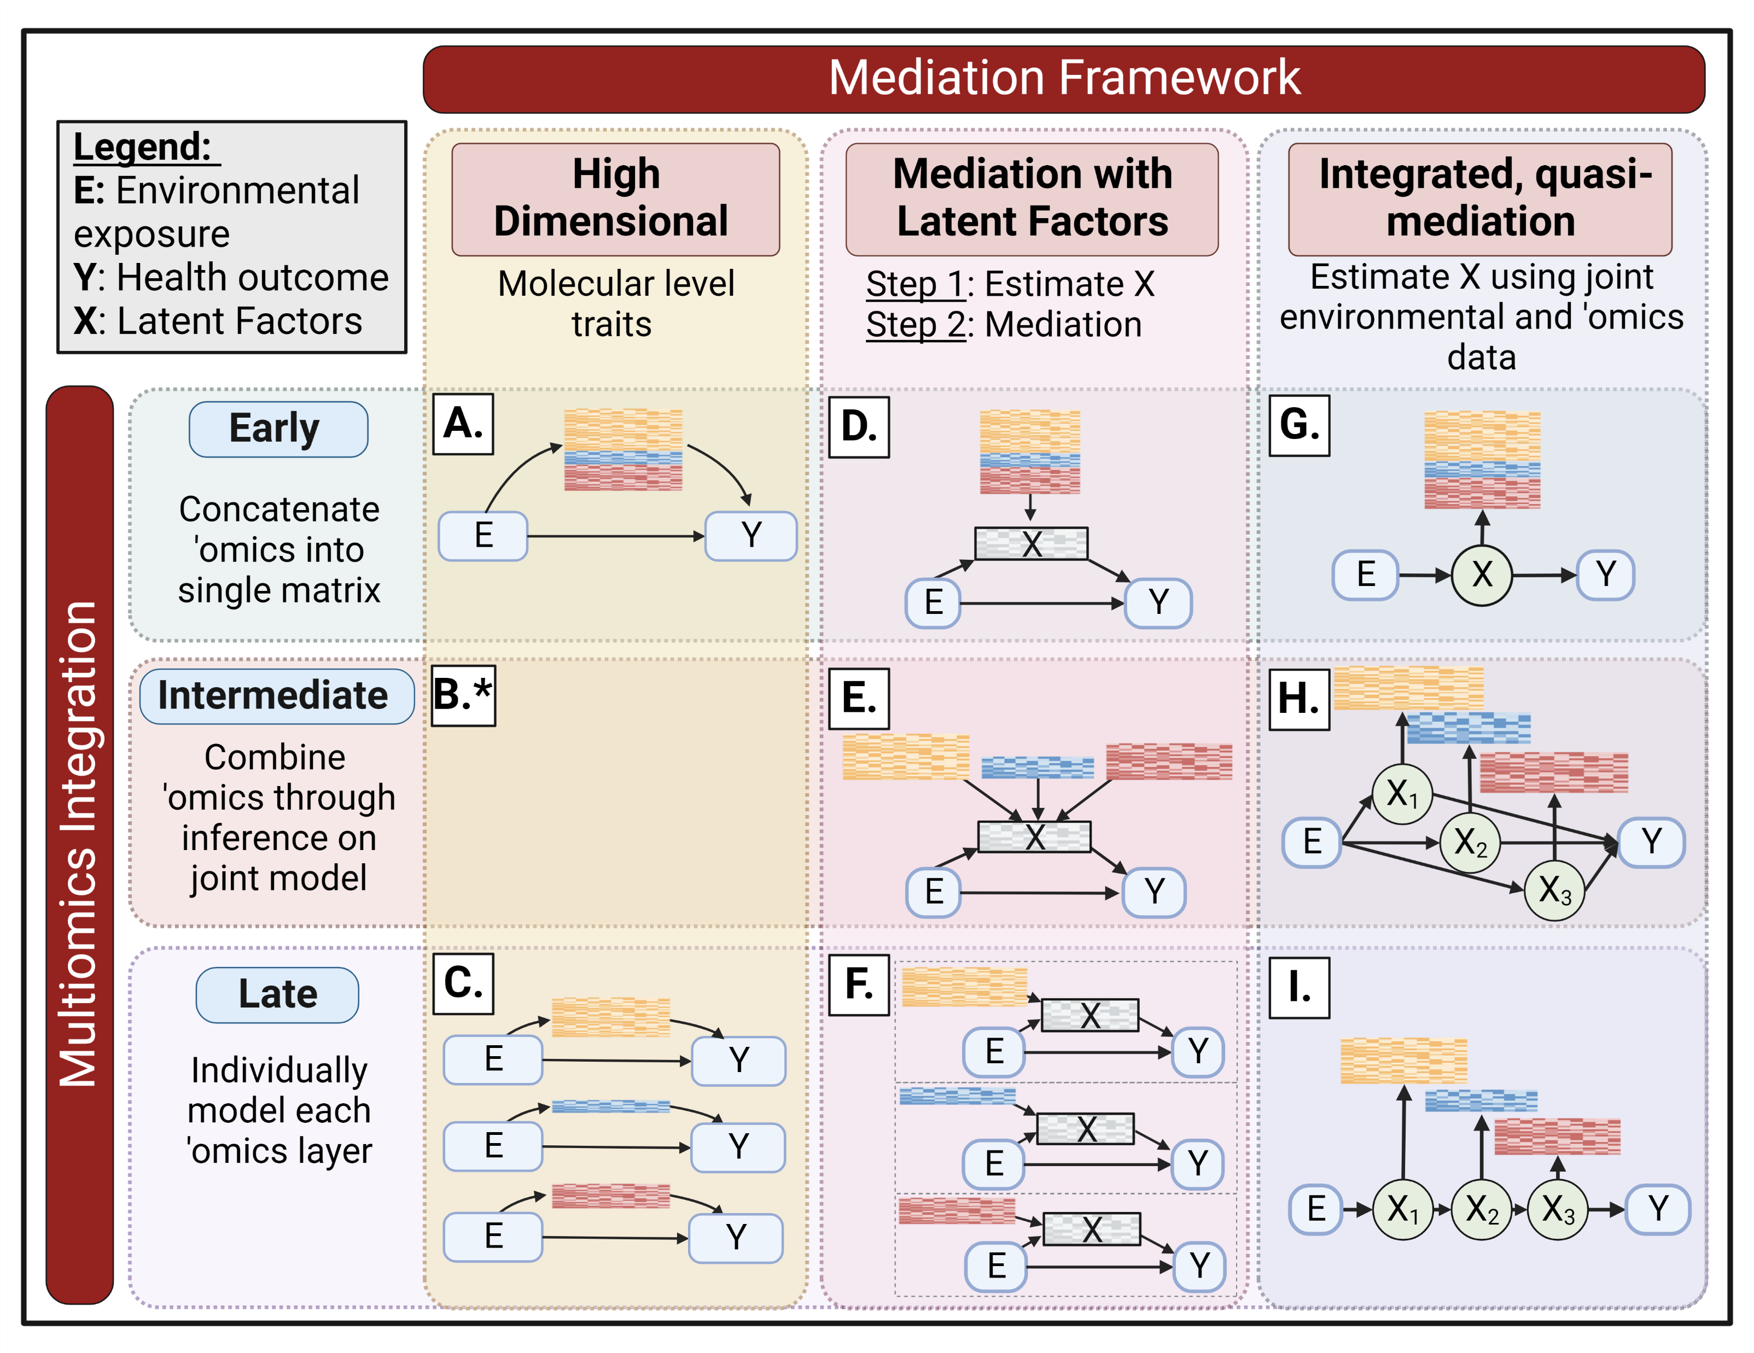
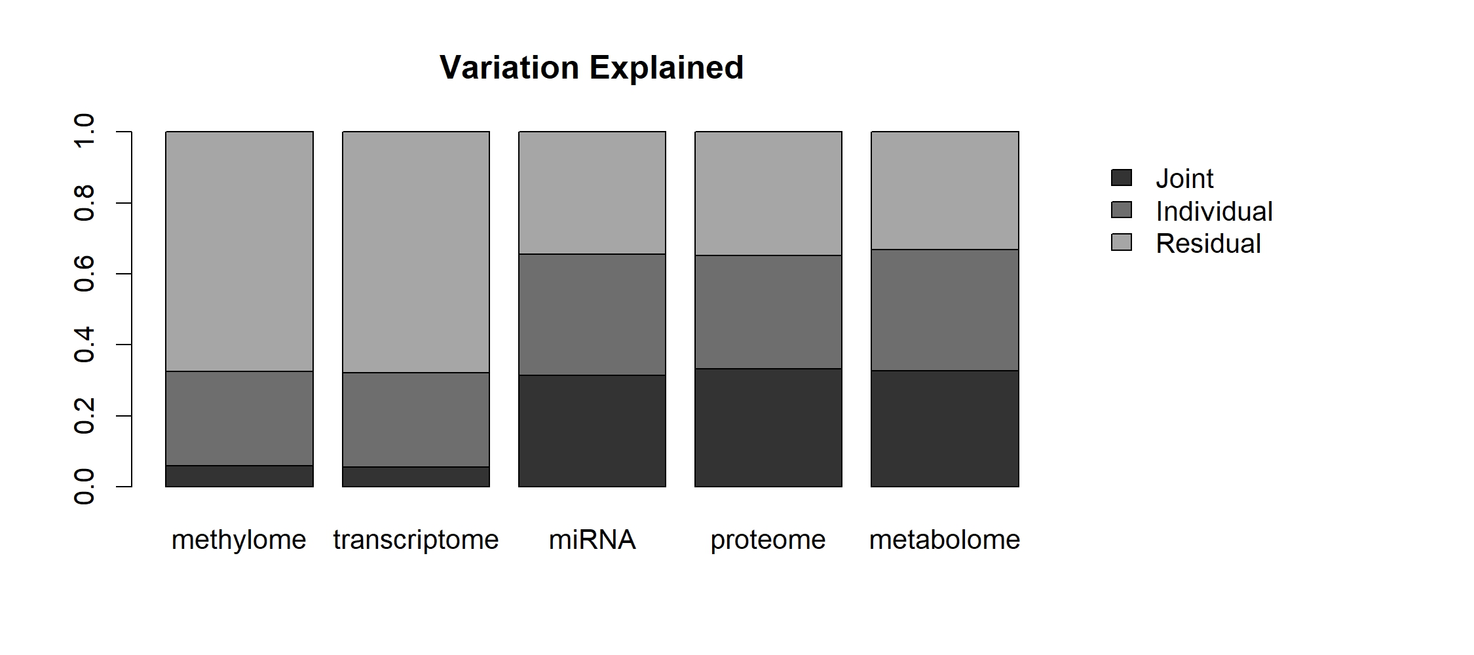
Step 1: JIVE Results
Notes:
So for this analysis, I am really going to focus first on the results of the JIVE output. The other two approaches are just PCA, which is pretty straight forward. But here, you see a plot illustrating the variance explained by each of the low rank matrices (talk through results)

Slide 24
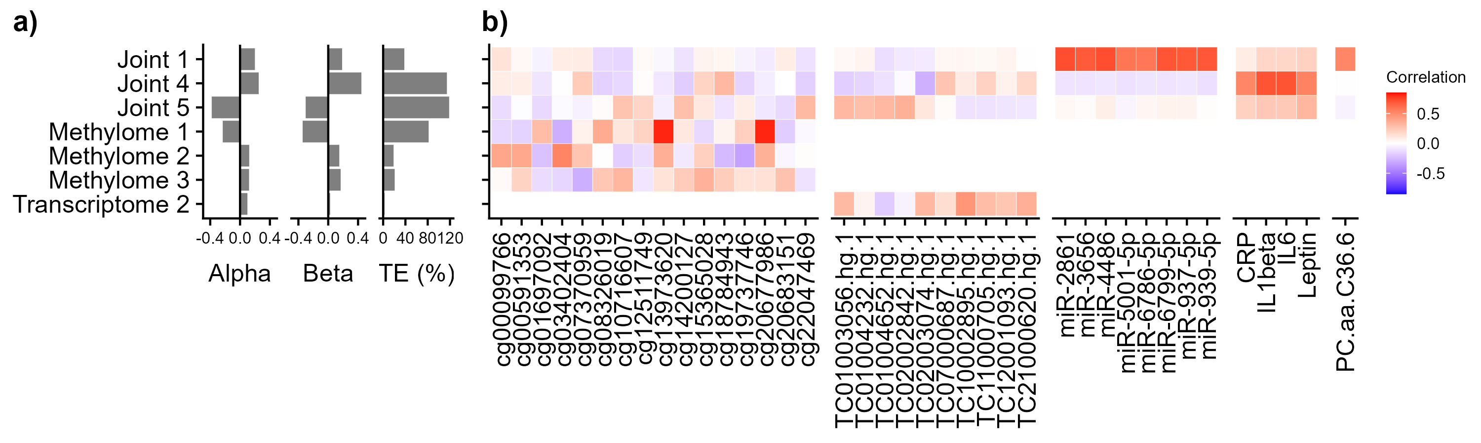
Step 1: JIVE Results
Step 2: Mediation Results
Notes:
So then, we took those low-rank matrices and used those matrices in the mediation analysis using HIMA. Here, you see the results (explain)

Slide 25
Feature Level Associations for Biological Interpretation
Notes:
So this is great, but doesn’t really tell you all that much by itself. So we then looked at which features were driving each of these factors (joint and individual). Click
Explain what this means, (next slides are animations)

Slide 26
Feature Level Associations for Biological Interpretation

Slide 27
Feature Level Associations for Biological Interpretation

Slide 28
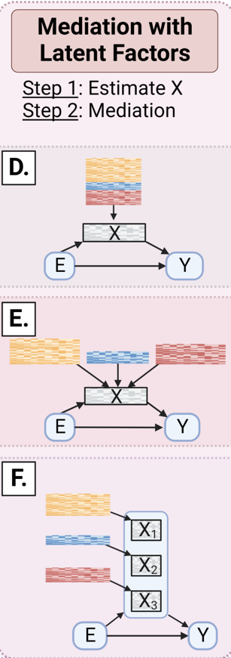
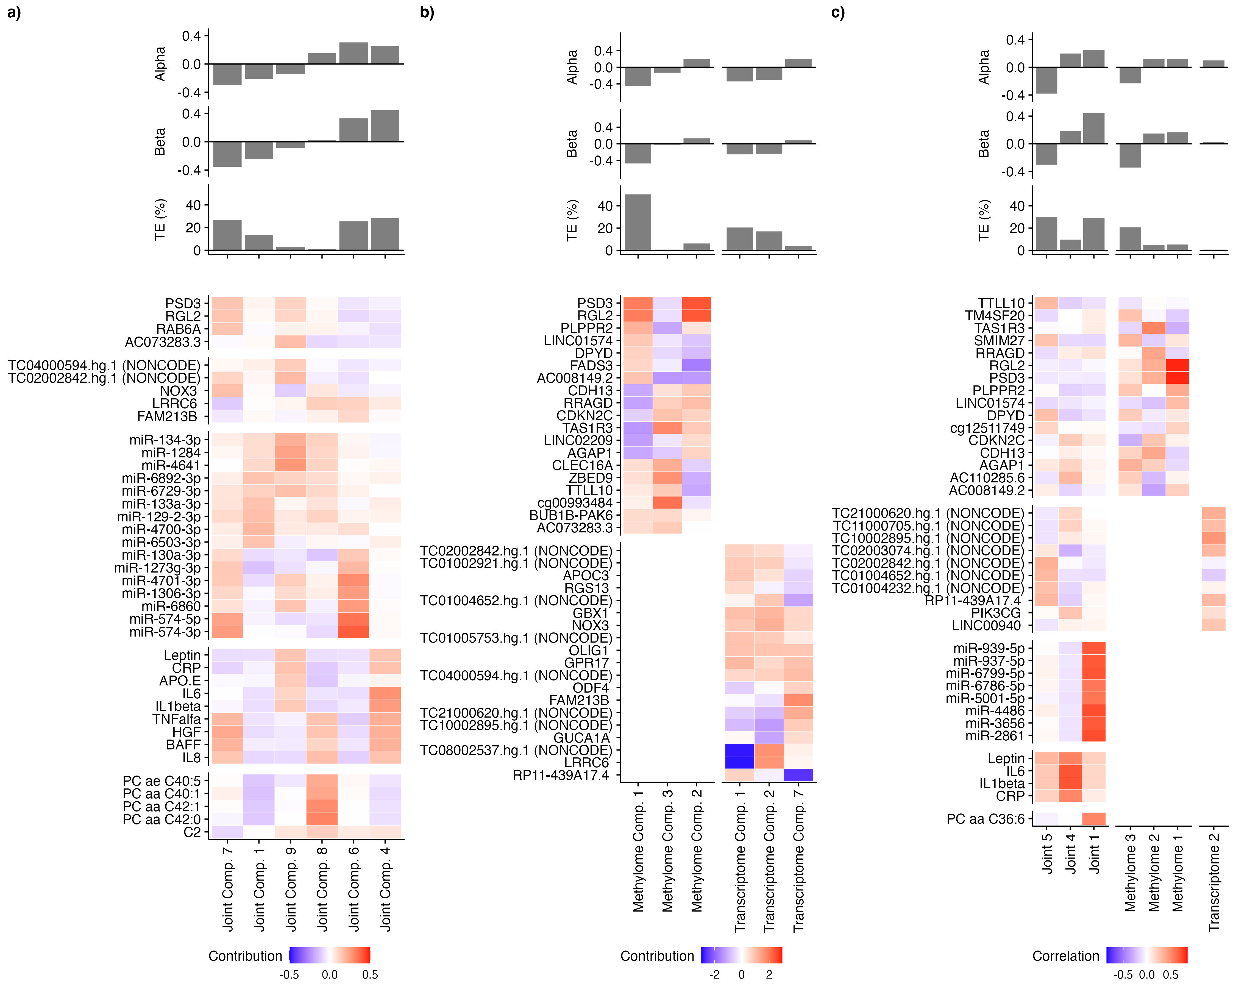
Approach 2: Intermediate Integration

Slide 29
Approach 2: Early Integration

Slide 30
Approach 2: All Results

Slide 31
Dimensionality reduction could also be clustering
Epigenome
miRNA
Transcriptome
Proteome
Metabolome
IntNMF
Clusters
PFNA
Liver Injury
Mediation tested using r package mediate
31
Notes:
Joint clustering based on non-negative matrix factorization
Data shifted and rescaled- all data must be greater than 0
integrative non-negative matrix factorization

Slide 32
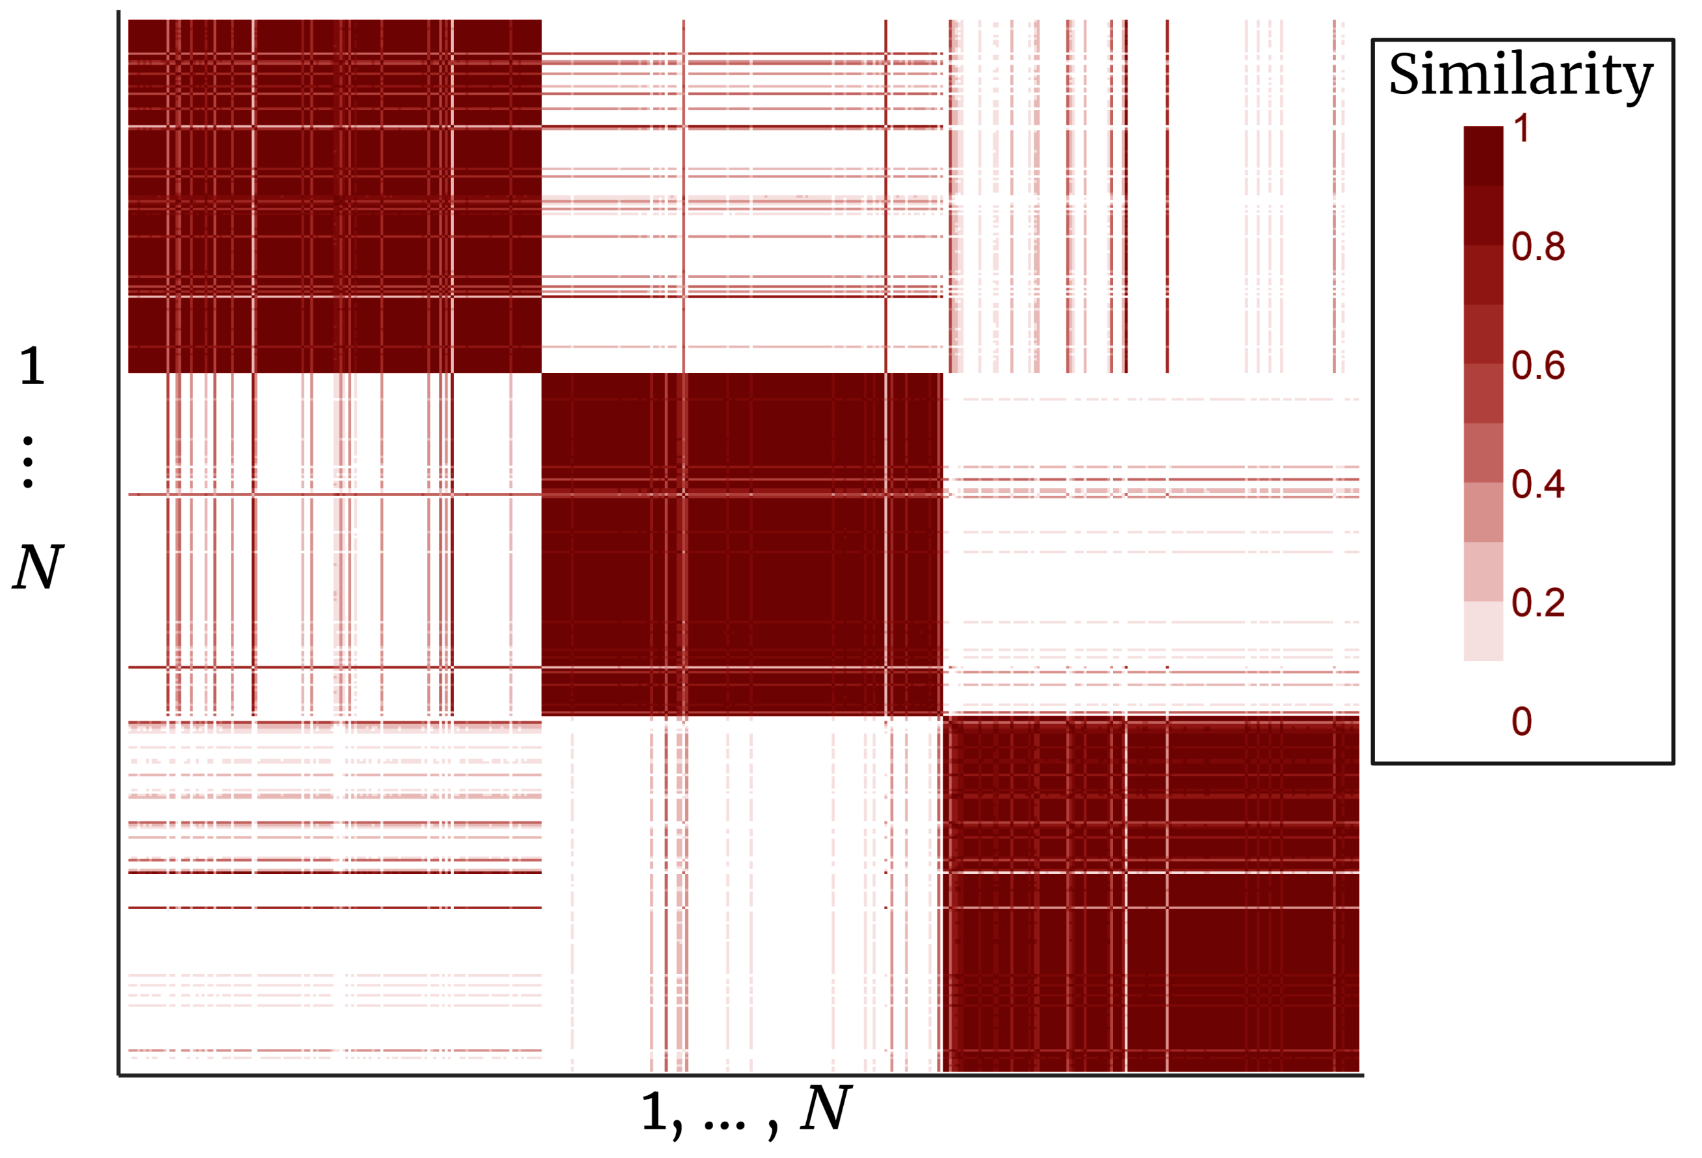
Intermediate Integration, IntNMF: Consensus Matrix
Consensus Matrix of IntNMF Results
Represents similarity between individuals
Three clear clusters
32

Slide 33
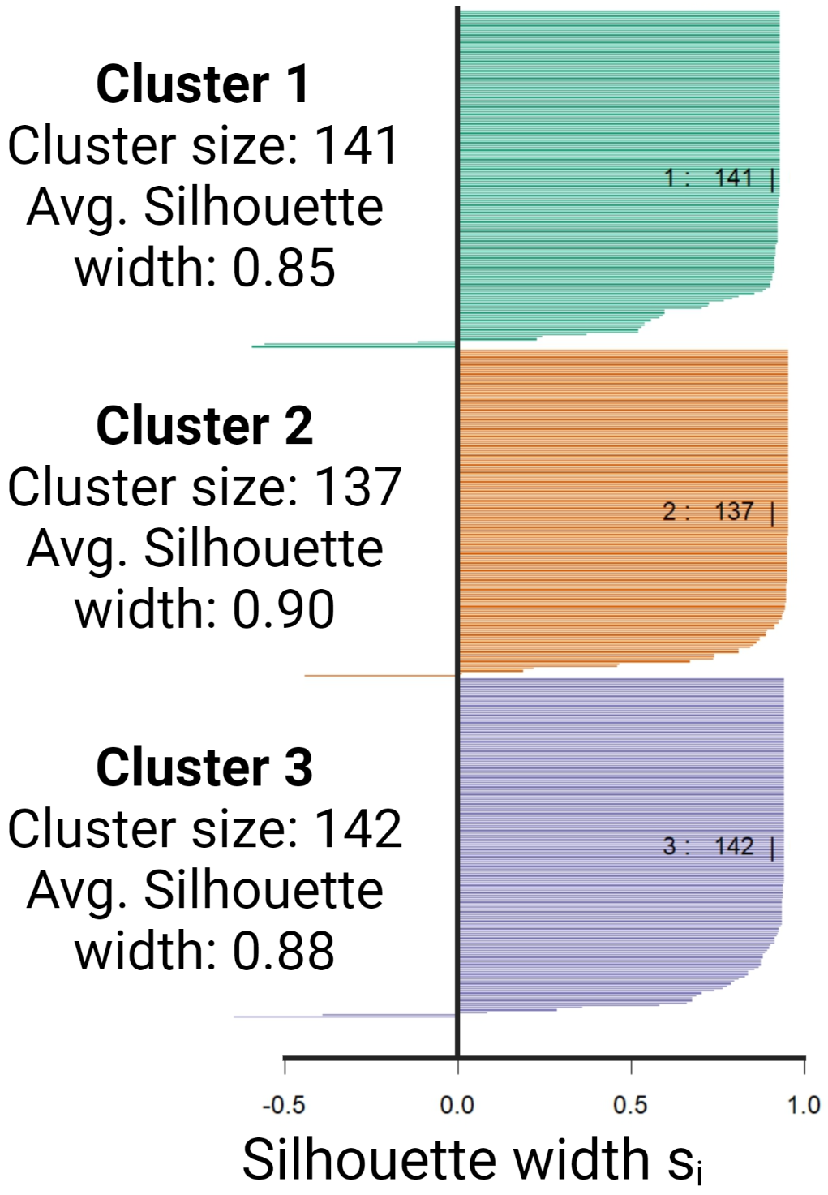
Intermediate Integration, IntNMF: Silhouette Plot
IntNMF performs well at identifying clusters of individuals with similar multi-omic profiles
… but none of these clusters were associated with maternal arsenic exposure
33

Slide 34
Approach 3: Integrated/ quasi-mediation
Identifying High Risk Populations

Slide 35
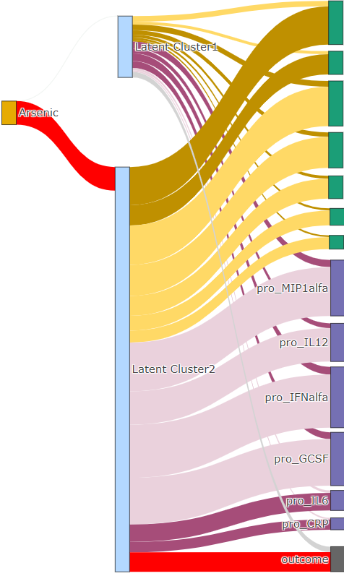
Results: Joint analysis, Early Integration
Notes:
Here you see the results of lucid with early integration. DESCRIBE FIG- middle shows high risk and low risk clusters.
As you can see, LUCID only selects transcripts and proteins to describe the high-risk clusters. This is partly because it performs feature selection on the omics, and these features are really strongly associated with the outcome in our data.

Slide 36
Joint analysis, intermediate integration
Modeling Omics in Parallel
Extension of LUCID, an Integrative Clustering Model for Multi-omics
Multiple omics (parallel and/or serial measurements)
Handle block missingness, sporadic, and combined
Estimate tuning parameters (xtune+)
Incorporate prior covariates (xrnet+)
Notes:
So moving on to intermediate integration. This shows an extension of lucid where the omics are modeled in parallel.

Slide 37
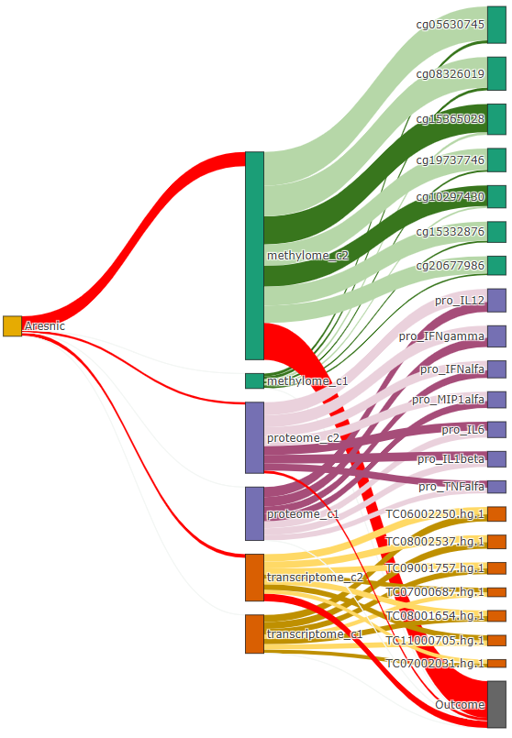
Results: Joint analysis, intermediate integration
Integrated information on Environmental exposures, DNA methylation, protein levels, and transcripts can identify groups of children at elevated risk of liver injury
Notes:
Here you really see that the epigenome is really driving some of these associations.

Slide 38
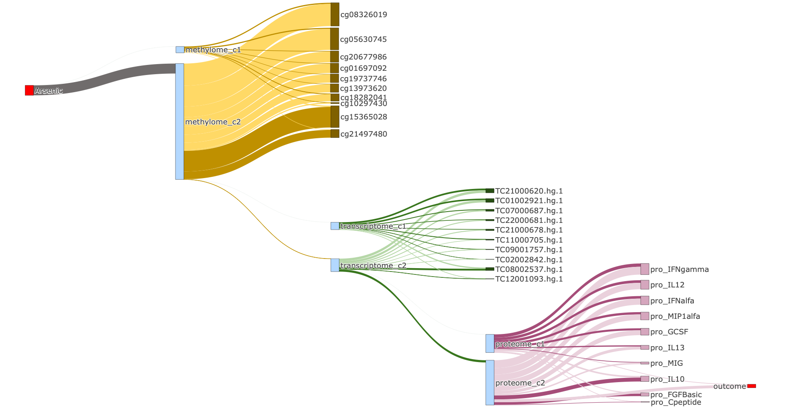
Results: LUCID, Late Integration (In Serial)

Slide 39
Different Approaches for Integration Provide Complementary Insights on Environmental Drivers of Disease
In Summary
Manuscript & Code for Analysis Are Forthcoming…

Slide 40
Summary: modeling omics jointly vs. independently
In joint models:
Condition out highly correlated variables, and only select features that are most “important” (defined by the algorithym).
Some significant “hits” might be correlated with “causal” variables in another layer
Good for feature selection
In independent models:
Fitting mediation model on each omics layer/ omics feature separately omits the correlation structure
Select all feature associated with the outcome
Good when you want to perform post hoc pathway analysis (i.e., biological interpretation)

Slide 41
Concluding Remarks
Many options for this analysis, but each tends to identify DNA methylation and gene expression as mediating factors.
Techniques specifically designed for multi-omics data work better at identifying robust multi-omics signatures (factors and/or clusters)
In practice, deciding on a data analysis approach should be driven by your research question
In reality, real data is messy and different approaches may work better or worse in practice.
You could use these methods for interaction analysis instead of mediation

